Slide 1
BOLO Flyer Creator
David Vizcaino – Developer
Yamila Fleitas – Developer
Major Jason Cohen – Mentor
Dr. Masoud Sadjadi - Instructor

Slide 2
Current System
Crime Scene Reports on Persons of Interest
Crime Scene Report = Be On the Look Out (BOLO) Flyer
Report created and then given to Supervisor
Supervisor approves or rejects
Exported to PDF and distributed via email.

Slide 3
Problem Definition
BOLO PDFs are sent via email
Easy to lose track of
Massive amounts of emails between individuals and departments
Decentralized = Unsearchable
Tedious and time consuming

Slide 4
Previous Version Limitations
Some limitations were…
Inability to edit from homepage.
Inability to download BOLOs other than your own.
Inability to delete agencies.
Unintuitive archive page.
Unintuitive format for adding Agency logos.

Slide 5
Requirements: Implemented User Stories
US#404 – Add Archive link to each BOLO.
US#445 – Redesign archive functionality
US#441 – Change email source
US#456 – Modify color schema
US#89 – Preview BOLOs before creation
US#491 – Add individual logos to Agencies during creation
US#471 – Destroy archived BOLO feature addition
US#486 – Ability to restore a BOLO
US#480 – Create new archive page
US#459 – Ability for admins to edit Agency info.
US#452 – Remove unnecessary BOLO details
US#462 – Ability for Admin to delete Agencies.

Slide 6
Requirements: Implemented User Stories
US#494 – Overhaul BOLO preview
US#490 – Attach BOLO flyer to Emails
US#519 – Redesign Alerts Page
US#493 – Filter email Alerts by Agency feature
US#537 – Update use case diagrams for each actor
US#542 – Create “Show My BOLOs” display filter.
US#123 – Add 2-step verification for BOLO archival
US#461 – Add Recovered category to update options
US#557 – Fix Diagrams
US#555 – Refactor Project Documentation
US#548 – Refactor User Guides
US#541 – Export PDFs of previously created BOLOs.

Slide 7
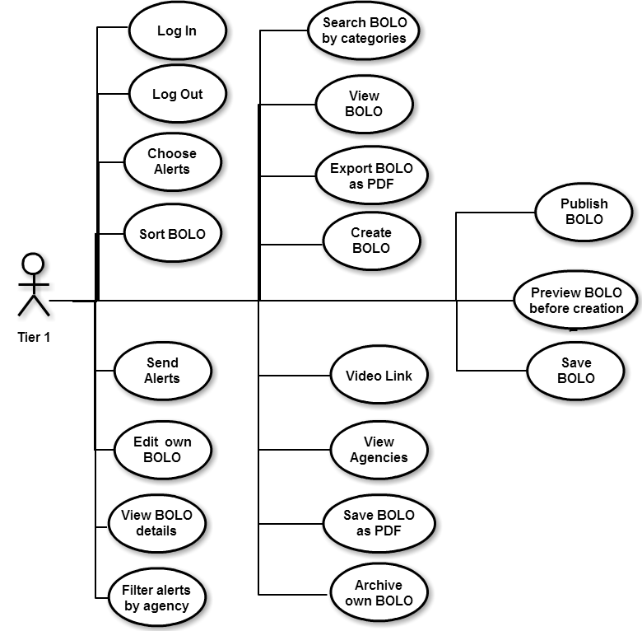
Requirements: Use Case Diagrams
Reduce time from occurrence of crime to generation of BOLO
Simple BOLO generation
Create BOLOs on site

Slide 8
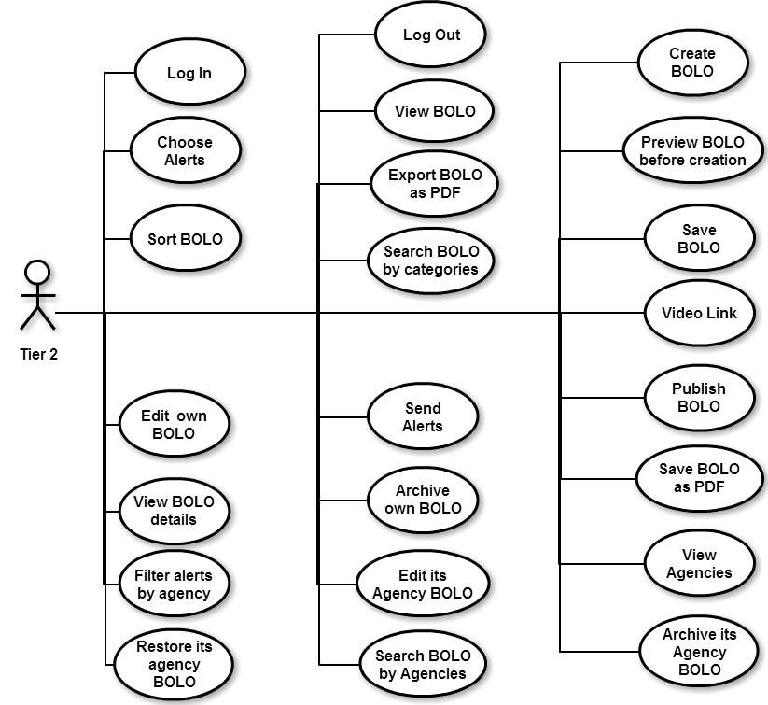
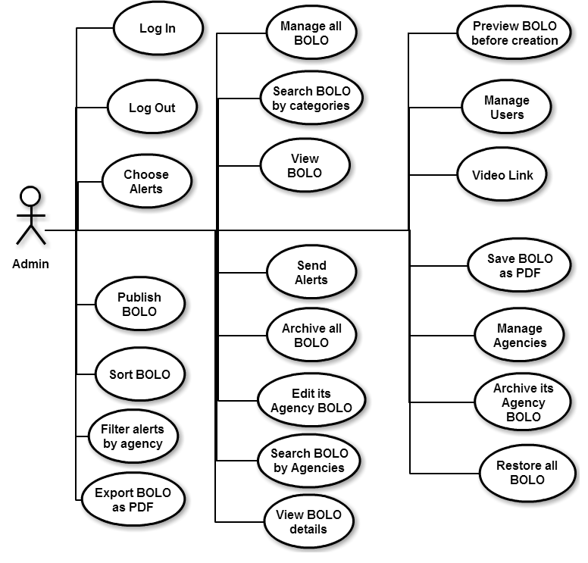
Requirements: Use Case Diagrams (Cont.)

Slide 9
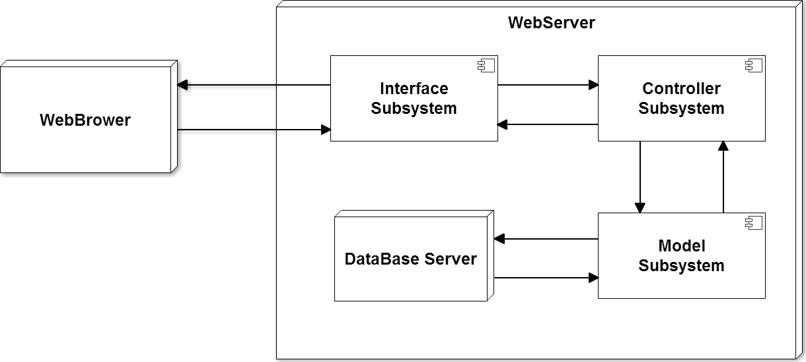
System Design: Decomposition
One main architecture:
Client – Server Architecture

Slide 10
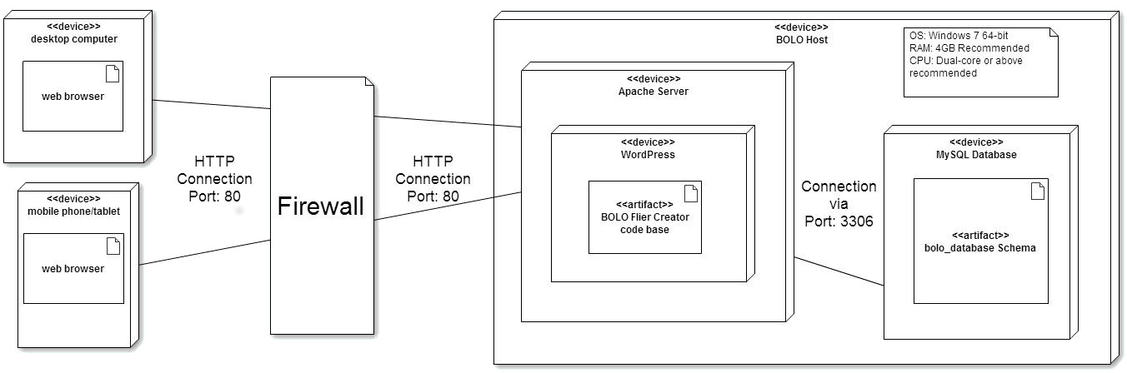
System Design: Deployment
Software Requirements: WAMP Server and WordPress.

Slide 11
System Design: Persistent Data
Four kinds of data stored:
User information:
Data such as: name, Agency, rank, user tier, etc.
BOLO information
Data such as: creation date, summary, author, etc.
Some information is copied to a second database for archival.
Agency information:
Data such as: name, address, logos, etc.
WordPress Information:
Internal WordPress information for page generation and linkage.

Slide 12
System Design: Security
Simple firewall used
Users must login to access website
User creation managed by Administrator(s)
Passwords hashed and salted
Simple SQL injection protection

Slide 13
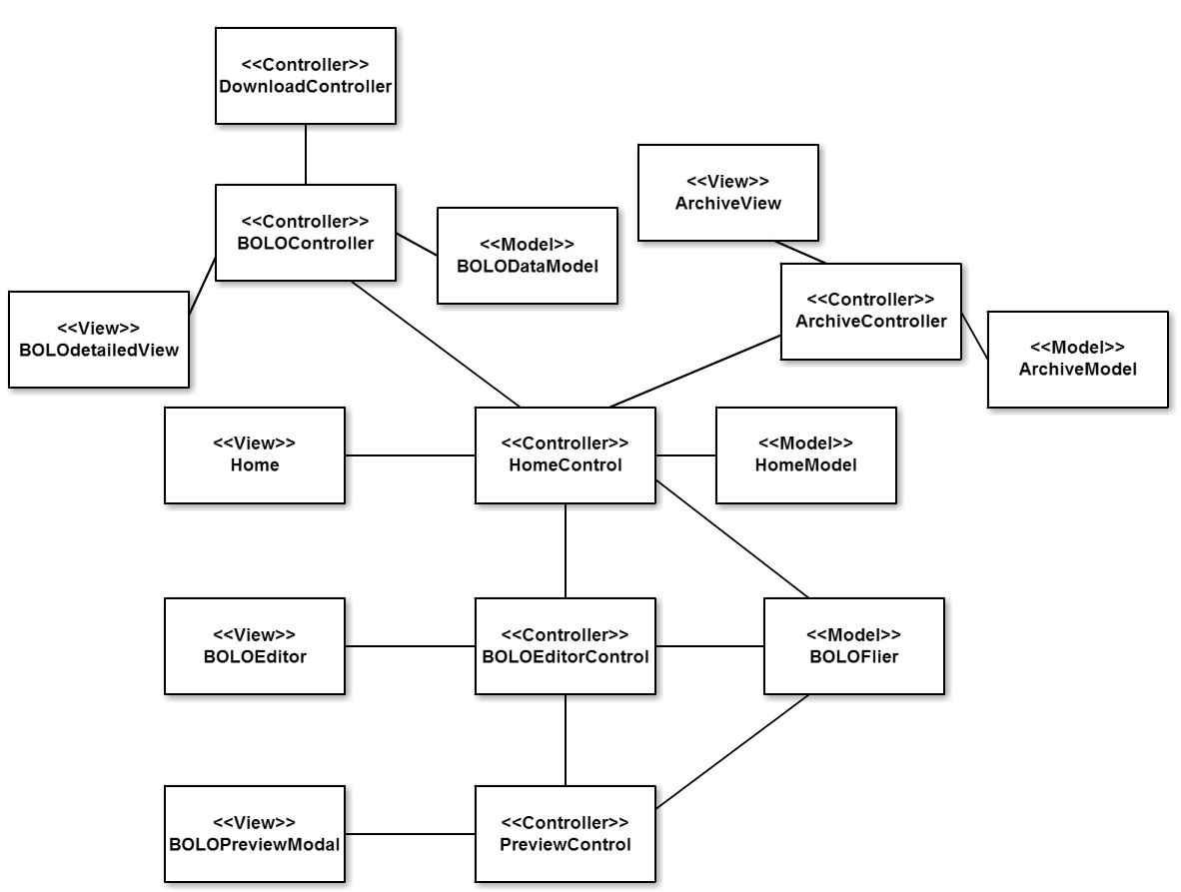
Detailed Design: Class Diagram

Slide 14
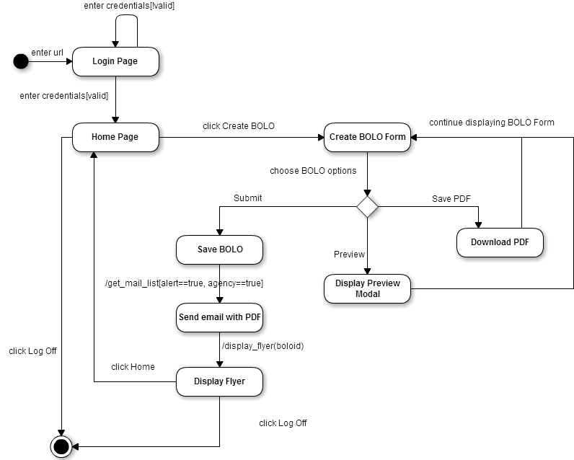
Detailed Design: State Machine

Slide 15
Detailed Design: Algorithm
BOLO Preview Algorithm
Due to limitations, could not implement in a way similar to rest of code.
Ajax + JQuery
Grab BOLO info and create BOLO
Display page and immediately delete from server
If a mobile device, display Modal informing of new tab
Switch user to tab after specified time
If desktop, generate modal and resize according to user screen
Display BOLO in modal

Slide 16
Verification
Test Case ID | BOLO 89 - SUNNY
Purpose | To validate the ability to preview PDFs of BOLOs being created
Preconditions | User needs to be logged into system and creating a BOLO.
Input | Click on the Preview button
Expected Result | The BOLO PDF is successfully shown in a popup window

Slide 17
Verification (cont)
Test Case ID | BOLO 89 - RAINY
Purpose | To validate the ability to preview BOLOs created by the user in a nonstandard screen size.
Preconditions | User has to be logged in and creating a BOLO on nonstandard display
Input | Click on Preview Button
Expected Result | BOLO is successfully shown in a popup window and viewable even when resizing display.

Slide 18
Verification Script (iMacro)
VERSION BUILD=8340723 RECORDER=CR
URL GOTO=http://bolo.cs.fiu.edu/bolofliercreator/?page_id=6
TAG POS=1 TYPE=SELECT FORM=ID:boloForm ATTR=ID:selectcat CONTENT=%BURGLARY
TAG POS=1 TYPE=INPUT:FILE FORM=ID:boloForm ATTR=ID:picture CONTENT=C:\fakepath\1437303872858.jpg
TAG POS=1 TYPE=INPUT:TEXT FORM=ID:boloForm ATTR=ID:name CONTENT=John
TAG POS=1 TYPE=INPUT:TEXT FORM=ID:boloForm ATTR=ID:lastName CONTENT=Test
TAG POS=1 TYPE=BUTTON FORM=ID:boloForm ATTR=NAME:save
TAG POS=12 TYPE=DIV ATTR=TXT:
TAG POS=1 TYPE=A ATTR=ID:preview
TAG POS=1 TYPE=BUTTON FORM=ID:boloForm ATTR=TXT:Close
TAG POS=1 TYPE=SELECT FORM=ID:boloForm ATTR=ID:haircolor CONTENT=%Gray
TAG POS=1 TYPE=SELECT FORM=ID:boloForm ATTR=ID:sex CONTENT=%Male
TAG POS=1 TYPE=A ATTR=ID:preview
TAG POS=1 TYPE=BUTTON FORM=ID:boloForm ATTR=TXT:Close

Slide 19
DEMO
BOLO Preview
BOLO Creation
BOLO Update
BOLO Archive
Enjoy!

